Slide 1
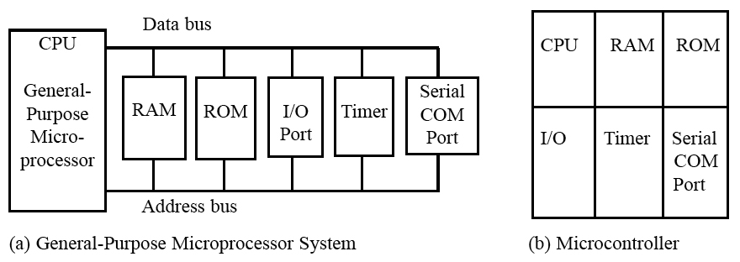
MICROCONTROLLERS AND EMBEDDED PROCESSORS
Microcontroller versus general-purpose microprocessor
Figure 1–1 Microprocessor System Contrasted With Microcontroller System[1]
1

Slide 2
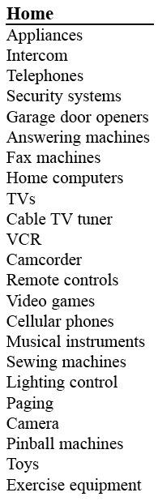
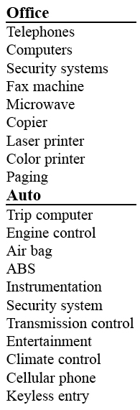
MICROCONTROLLERS AND EMBEDDED PROCESSORS
Microcontrollers for embedded systems
Table 1–1
Some Embedded Products
Using Microcontrollers[1]
2

Slide 3
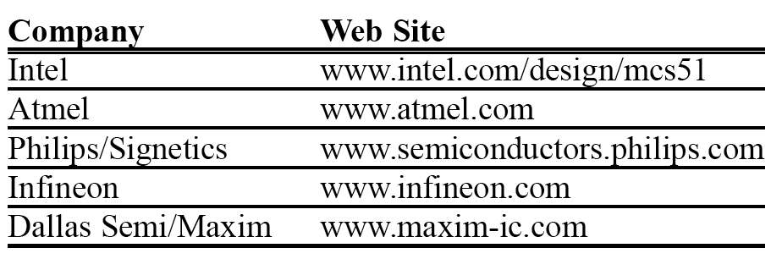
MICROCONTROLLERS AND EMBEDDED PROCESSORS
Choosing a microcontroller
Table:-Various Manufacturers of Microcontrollers
3

Slide 4
MICROCONTROLLERS AND EMBEDDED PROCESSORS
CRITERIA FOR CHOOSING A MICROCONTROLLER
Speed
packaging
Power consumption
Amount of RAM/ROM
No. of I/O pins and timer
Upgrade
Cost per unit
4

Slide 5
CRITERIA FOR CHOOSING A MICROCONTROLLER
Availability of assembler, compiler.
Availability and reliable sources
5

Slide 6
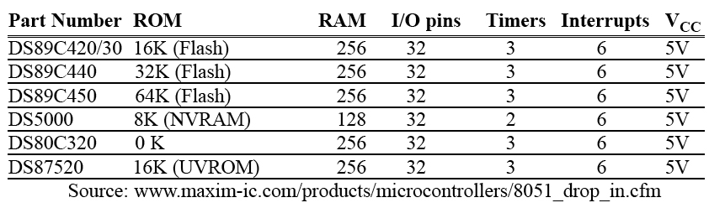
MICROCONTROLLERS AND EMBEDDED PROCESSORS
Table 1–5
Versions of 8051/52 Microcontroller From Dallas Semiconductor (Maxim)
6

Slide 7
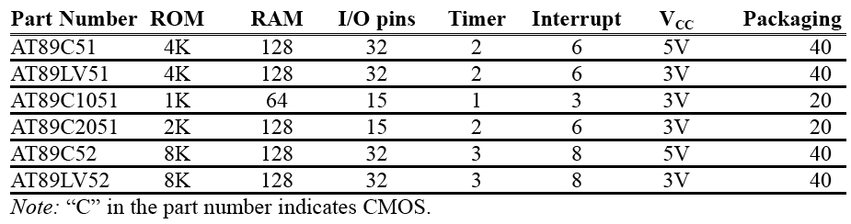
MICROCONTROLLERS AND EMBEDDED PROCESSORS
Table 1–6 Versions of 8051 From Atmel (All ROM Flash)
7

Slide 8
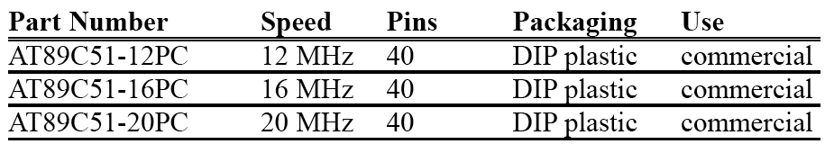
MICROCONTROLLERS AND EMBEDDED PROCESSORS
Table 1–7 Various Speeds of 8051 From Atmel
8

Slide 9
A brief history of the 8051
In 1981, Intel Corporation introduced an 8-bit microcontroller called the 8051.
This microcontroller had 128 bytes of RAM, 4K bytes of on-chip ROM, two timers, one serial port, and four ports (each 8-bits wide) all on a single chip.
The 8051 is an 8-bit processor, meaning that the CPU can work on only 8 bits of data at a time.
Data larger than 8 bits has to be broken into 8-bit pieces to be processed by the CPU.
8

Slide 10
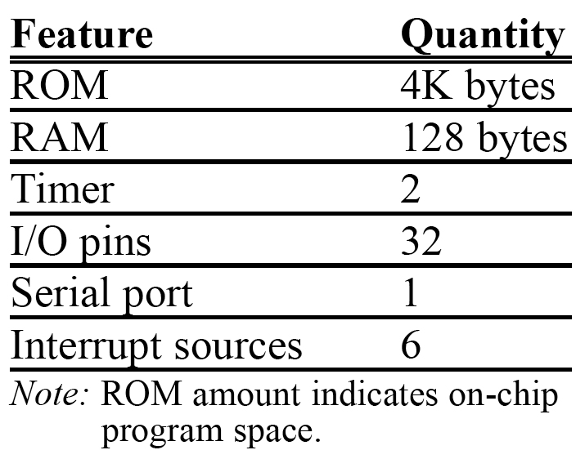
FEATURES OF 8051[1]
8

Slide 11
A brief history of the 8051
The 8051 has a total of four I/O ports, each 8 bits wide.
Although the 8051 can have a maximum of 64K bytes of on-chip ROM, many manufacturers have put only 4K bytes on the chip.
The 8051 became widely popular after Intel allowed other manufacturers to make and market any flavors of the 8051 they please with the condition that they remain code-compatible with the 8051.
This has led to many versions of the 8051 with different speeds and amounts of on-chip ROM marketed by more than half a dozen manufacturers.
8

Slide 12
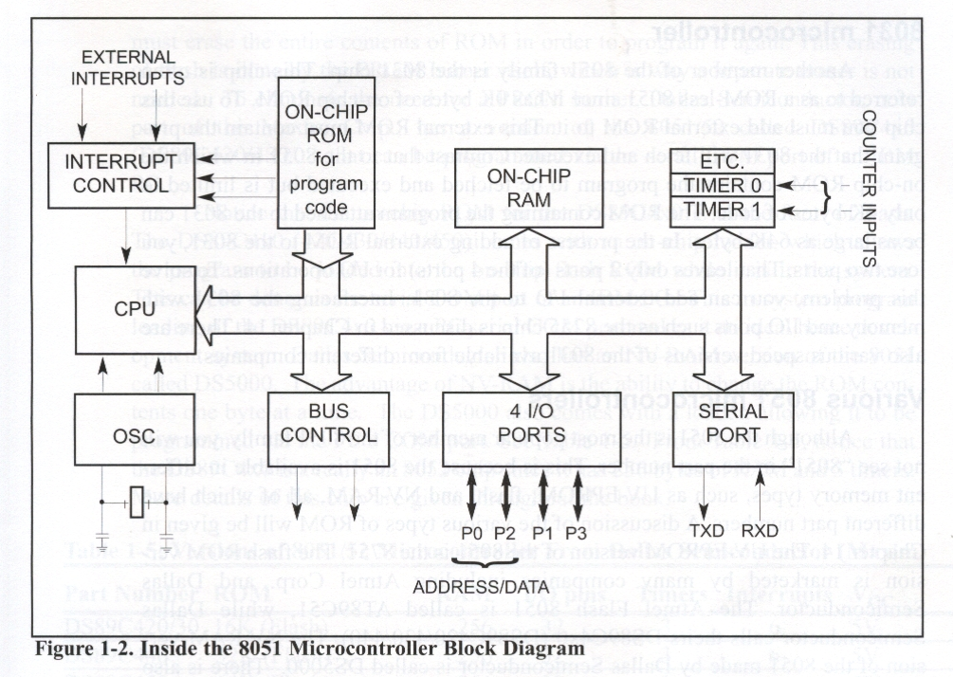
OVERVIEW OF THE 8051 FAMILY[1]
8

Slide 13
8052 microcontroller
The 8052 is another member of the 8051 family.
The 8052 has all the standard features of the 8051 as well as an extra 128 bytes of RAM and an extra timer.
8052 has 256 bytes of RAM and 3 timers.
It has 8K bytes of on-chip program ROM instead of 4K bytes.
8

Slide 14
8031 microcontroller
This chip is often referred to as a ROM-less 8051 since it has 0K bytes of on-chip ROM.
To use this chip you must add external ROM to it.
This external ROM must contain the program that the 8031 will fetch and execute.
The ROM containing the program attached to the 8031 can be as large as 64K bytes.
In the process of adding external ROM to the 8031, you lose two ports.
To solve this problem, you can add external I/O to the 8031. Interfacing the 8031 with memory and I/O ports such as the 8255 chip is discussed in Chapter 15.
8

Slide 15
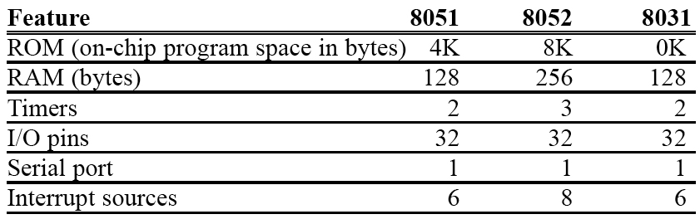
MICROCONTROLLERS AND EMBEDDED PROCESSORS
Table 1–4 Comparison of 8051 Family Members[1]
15

Slide 16
Various 8051 microcontrollers
The 8051 is available in different memory types, such as UV-EPROM, flash, and NV-RAM, all of'which have different part numbers.
The UV-EPROM version of the 8051 is the 8751.
The flash ROM version is marketed by many companies including Atmel Corp. and Dallas Semiconductor.
The Atmel Flash 8051 is called AT89C51, while Dallas Semiconductor calls theirs DS89C4xO (DS89C420/430/440).
The NV-RAM version of the 8051 made by Dallas Semiconductor is called DS5000.
There is also an OTP (one-time programmable) version of the 8051 made by various manufacturers.
15

Slide 17
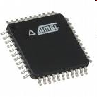

AT89S8253 from Atmel Corporation
We will be using this version of the 8051 in the lab. Each student will be given a chip to program.
Look at the specs of this version at http://www.atmel.com/dyn/resources/prod_documents/doc3286.pdf
15

Slide 18
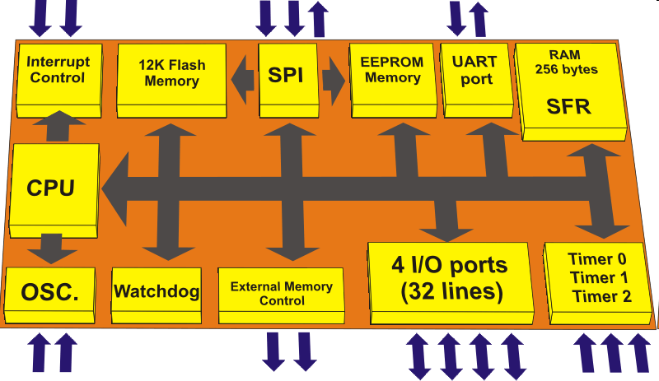
AT89S8253 from Atmel Corporation[3]
15

Slide 19
8051 features
The Intel 8051 is a very popular general purpose microcontroller widely used for small scale embedded systems. Many vendors such as Atmel, Philips, and Texas Instruments produce MCS-51 family microcontroller chips.
The 8051 is an 8-bit microcontroller with 8 bit data bus and 16-bit address bus. The 16 bit address bus can address a 64K( 2¹⁶) byte code memory space and a separate 64K byte of data memory space. The 8051 has 4K on-chip read only code memory and 128 bytes of internal Random Access Memory (RAM)
Notes:
<number>
<number>

Slide 20
Features
Besides internal RAM, the 8051 has various Special Function Registers (SFR) such as the Accumulator, the B register, and many other control registers.
34 8-bit general purpose registers in total.
The ALU performs one 8-bit operation at a time.
Two 16 bit /Counter timers
3 internal interrupts (one serial), 2 external interrupts.
4 8-bit I/O ports (3 of them are dual purposed). One of them used for serial port,
Some 8051 chips come with UART for serial communication and ADC for analog to digital conversion.
Notes:
<number>

Slide 21
8051 Chip Pins
40 pins on the 8051 chip.
Most of these pins are used to connect to I/O devices or external data and code memory.
4 I/O port take 32 pins(4 x 8 bits) plus a pair of XTALS pins for crystal clock
A pair of Vcc and GND pins for power supply (the 8051 chip needs +5V 500mA to function properly)
A pair of timer pins for timing controls, a group of pins (EA, ALE, PSEN, WR, RD) for internal and external data and code memory access controls
One Reset pin for reboot purpose
Notes:
<number>
<number>

Slide 22
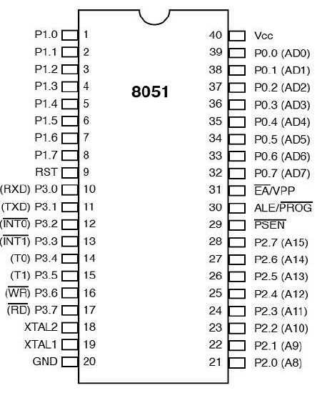
Pin Diagram of 8051
21

Slide 23
The Pin Connection for External Code and Data Memory
Notes:
<number>
<number>

Slide 24
The EA' (External Access) pin is used to control the internal or external memory access.
The signal 0 is for external memory access and signal 1 for internal memory access.
The PSEN' (Program Store Enable) is for reading external code memory when it is low (0) and EA is also 0.
The ALE (Address Latch Enable) activates the port 0 joined with port 2 to provide 16 bit external address bus to access the external memory. The ALE multiplexes the P0:
1 for latching address on P0 as A0-A7 in the 16 bit address buss, 0 for latching P0 as data I/O.
P0.x is named ADx because P0 is multiplexed for Address bus and Data bus at different clock time.
WR' only provides the signal to write external data memory
RD' provides the signal to read external data and code memory.
Notes:
<number>

Slide 25
System Clock and Oscillator Circuits
The 8051 requires an external oscillator circuit. The oscillator circuit usually runs around 12MHz. the crystal generates 12M pulses in one second. The pulse is used to synchronize the system operation in a controlled pace..
A machine cycle is minimum amount time a simplest machine instruction must take
An 8051 machine cycle consists of 12 crystal pulses (clock cycle).
instruction with a memory operand so that it needs multiple memory accesses.
Notes:
<number>
<number>

Slide 26
Contd.
The first 6 crystal pulses (clock cycle) is used to fetch the opcode and the second 6 pulses are used to perform the operation on the operands in the ALU. This gives an effective machine cycle rate at 1MIPS (Million Instructions Per Second).
Crystal to 8051 XTAL 1/2
Notes:
<number>

Slide 27
The Port Alternate Functions
PORT P1 (Pins 1 to 8): The port P1 is a port dedicated for general I/O purpose. The other ports P0, P2 and P3 have dual roles in addition to their basic I/O function.
PORT P0 (pins 32 to 39): When the external memory access is required then Port P0 is multiplexed for address bus and data bus that can be used to access external memory in conjunction with port P2. P0 acts as A0-A7 in address bus and D0-D7 for port data. It can be used for general purpose I/O if no external memory presents.
PORT P2 (pins 21 to 28): Similar to P0, the port P2 can also play a role (A8-A15) in the address bus in conjunction with PORT P0 to access external memory.
Notes:
<number>
<number>

Slide 28
Contd.
PORT P3 (Pins 10 to 17):
In addition to acting as a normal I/O port,
P3.0 can be used for serial receive input pin(RXD)
P3.1 can be used for serial transmit output pin(TXD) in a serial port,
P3.2 and P3.3 can be used as external interrupt pins(INT0’ and INT1’),
P3.4 and P3.5 are used for counter input pins(T0 and T1),
P3.6 and P3.7 can be used as external data memory write and read control signal pins(WR’ and RD’)read and write pins for memory access.
Notes:
<number>
<number>

Slide 29
8051 Internal Architecture
The CPU is the heart of any computer which is in charge of computer operations.
The CPU has many important registers.
The Program Count (PC) always holds the code memory location of next instruction.
It fetches instructions from the code memory into the instruction Register (IR), analyzes the opcode of the instruction, updates the PC to the location of next instruction, fetches the operand from the data memory if necessary, and finally performs the operation in the Arithmetic-Logic Unit (ALU) within the CPU.
Notes:
<number>
<number>

Slide 30
Contd.
The B register is a register just for multiplication and division operation which requires more register spaces for the product of multiplication and the quotient and the remainder for the division.
The immediate result is stored in the accumulator register (Acc) for next operation
The Program Status Word (PSW) is updated depending on the status of the operation result.
Notes:
<number>
<number>

Slide 31
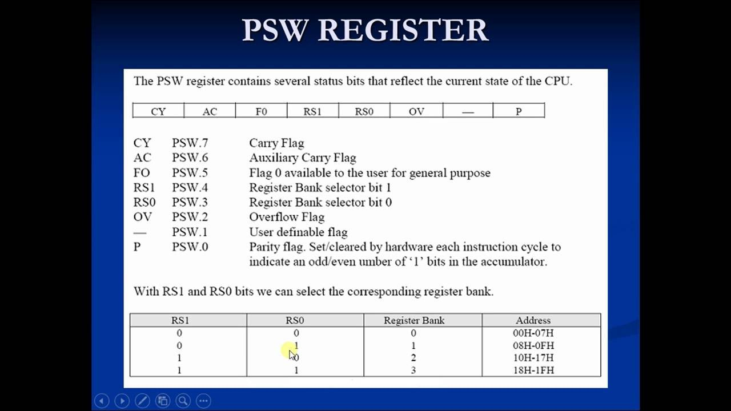
30

Slide 32
8051 Internal Architecture
Notes:
<number>

Slide 33
Ports Port Reading and Writing
There are 4 8-bit ports: P0, P1, P2 and P3. All of them are dual purpose ports except P1 which is only used for I/O. The following diagram shows a single bit in an 8051 I/O port.
Single Bit In I/O Port
Notes:
<number>
<number>

Slide 34
Contd.
When a C program writes a one byte value to a port or a single bit value to a bit of a port, just simply assign the value to the port as follows:
P1 ; or P1.2=1;
P1 represents the 8 bits of port 1 and P1.2 is the pin #2 of the port 1 of 8051 defined in the reg51.h of C51, a C dedicated for 8051 family.
Notes:
<number>
<number>

Slide 35
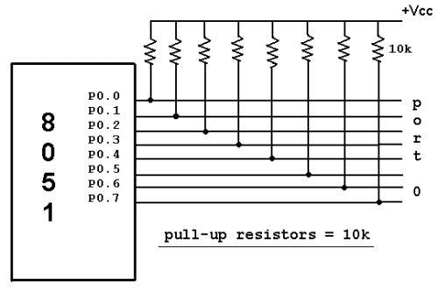
Port 0
Can be used as input or output.
Each pin must be connected to a 10 K-ohm pull up resistor.
35

Slide 36
Contd.
Port 0 as input
Port 0 can be configured first as an input port by writing 1 to all the bits.
MOV A,#0FFH;
MOV P0, A;
Port1
Can be used as input or output.
Donot need any pull up resistors
Upon RESET ,Port 1 is configured as an input port.
Notes:
<number>

Slide 37

Single bit instruction.
36

Slide 38
Memory and SFR
The 8051 code(program) memory is read-only, while the data memory is read/write accessible. The program memory( in EPROM) can be rewritten by the special programmer circuit.
The 8051 memory is organized in a Harvard Architecture. Both the code memory space and data memory space begin at location 0x00 for internal or external memory which is different from the Princeton Architecture where code and data share same memory space.
The advantage of the Harvard Architecture is not only doubling the memory capacity of the microcontroller with same number of address lines but also increases the reliability of the microcontroller, since there are no instructions to write to the code memory which is read only.
Notes:
<number>

Slide 39
Separate read instructions for external data and code memory.
Notes:
<number>
<number>

Slide 40
Contd.
The 8051 has 256 bytes of internal addressable RAM, although only first 128 bytes are available for general use by the programmer.
The first 128 bytes of RAM (from 0x00 to 0x7F) are called the direct memory, and can be used to store data.
The lowest 32 bytes of RAM are reserved for 4 general register banks. The 8051 has 4 selectable banks of 8 addressable 8-bit registers, R0 to R7.

Slide 41
Contd.
This means that there are essentially 32 available general purpose registers, although only 8 (one bank) can be directly accessed at a time.
The advantage of using these register banks is time saving on the context switch for interrupted program to store and recover the status.
Otherwise the push and pop stack operations are needed to save the current state and to recover it after the interrupt is over.
The default bank is bank 0.
The second 128 bytes are used to store Special Function Registers (SFR) that C51 program can configure and control the ports, timer, interrupts, serial communication, and other tasks.
Notes:
<number>
<number>

Slide 42
Special Function Registers (SFRs)
The SFR is the upper area of addressable memory, from address 0x80 to 0xFF. This area consists of a series of memory-mapped ports and registers.
All port input and output can therefore be performed by get and set operations on SFR port name such as P3.
Also, different status registers are mapped into the SFR for checking the status of the 8051, and changing some operational parameters of the 8051.
All 8051 CPU registers, I/O ports, timers and other architecture components are accessible in 8051 C through SFRs
They are accessed in normal internal RAM (080H – 0FFH) by 8051 C, and they all are defined in the header file reg51.h listed below.
Notes:
<number>

Slide 43
Contd.
There are 21 SFRs.
In addition to I/O ports, the most frequently used SFRs to control and configure 8051 operations are:
TCON (Timer CONtrol)
TMOD (Timer MODe)
TH0/TH1 and TL0/TL1 (Timer’s high and low bytes)
SCON (Serial port CONtrol)
IP (Interrupt Priority)
IE ( Interrupt Enable)
Almost all 8051 C embedded programs include the reg51.h.
Notes:
<number>

Slide 44
The sbit register variables of these SFRs defined in reg51.h often used in embedded C program.
1. TCON (Timer/Counter Control Register) SFR for timer control
TF0/TF1: Timer0/1 overflow flag is set when the timer counter overflows, reset by program
TR0/TR1: Timer0/1 run control bit is set to start, reset to stop the timer0/1
IE0/IE1: External interrupt 0/1 edge detected flag1 is set when a falling edge interrupt on the external port 0/1, reset(cleared) by hardware itself for falling edge transition-activated INT; Reset by code for low level INT.
IT0/IT1 External interrupt type (1: falling edge triggered, 0 low level triggered)
bit 7 | bit 6 | bit 5 | bit 4 | bit 3 | bit 2 | bit 1 | bit 0 (88H)
TF1 | TR1 | TF0 | TR0 | IE1 | IT1 | IE0 | IT0
Notes:
<number>
<number>

Slide 45
IE (Interrupt Enable Register) SFR used for interrupt control
bit 7 | bit 6 | bit 5 | bit 4 | bit 3 | bit 2 | bit 1 | bit 0 (A8H)
EA |  | ET2 | ES | ET1 | EX1 | ET0 | EX0
Notes:
<number>

Slide 46
PSW (Program Status Word) SFR for CPU status
P: parity check flag
OV: ALU overflow flag
RS0/RS1: Register bank specification mode
00: bank 0 (00H-07H); 01: bank1; 10: bank 2; 11: bank 3(18H-1FH)
F0: User defined lag
CY: ALU carry out
AC: ALU auxiliary carry out
bit 7 | bit 6 | bit 5 | bit 4 | bit 3 | bit 2 | bit 1 | bit 0
CY | AC | F0 | RS1 | RS0 | OV |  | P

Slide 47
P3( Port 3) SFR used for I/O and other special purposes
Addition to I/O usage, P3 can also be used for:
RXD/TXD: Receive/Transmit serial data for RS232
INT0, INT1: External interrupt port inputs
T0,T1: Alternative Timer 0/1 bit
WR/RD : Write/Read control bits used for external memory
If external RAM or EPROM is used, ports P0 and P2 are used to address the external memory.
Other port SFRs such as P0, P1, P2 are mainly used for data I/O.
bit 7 | bit 6 | bit 5 | bit 4 | bit 3 | bit 2 | bit 1 | bit 0
RD | WR | T1 | T0 | INT1 | INT0 | TxD | RxD
Notes:
<number>

Slide 48
6. TL0/TL1 SFRs: Lower byte of Timer 0/1, used to set timer interrupt period
TH0/TH1 SFRs: Higher byte of Timer 0,used to set timer interrupt period
7. TMOD ( Timer Mode Register)
Note: bit 0-3 for Timer0 and bit 4-7 for Timer1
bit 7 | bit 6 | bit 5 | bit 4 | bit 3 | bit 2 | bit 1 | bit 0
Gate | C/T | M1 | M0 | Gate | C/T | M1 | M0
Notes:
<number>

Slide 49
Working as a “Timer”, the timer is incremented by one every machine cycle. A machine cycle consists of 12 oscillator periods, so the count rate is 1/12 of the oscillator frequency.
Working as a “Counter”, the counter is incremented in response to a falling edge transition in the external input pins.
The external input is sampled once every machine cycle. A “high” sample followed by a low sample is counted once.
Timer 0 and Timer 1 have four operating modes.
M1, M0 Mode Control
0 0 (Mode 0) 13 bit count mode
0 1 (Mode 1) 16 bit count mode
1 0 (Mode 2) Auto reload mode
1 1 (Mode 3) Multiple mode
Notes:
<number>

Slide 50
8051 data type and directives
The 8051 microcontroller has only one data type. It is 8 bits, and the size of each register is also 8 bits.
It is the job of the programmer to break down data larger than 8 bits (00 to FFH, or 0 to 255 in decimal) to be processed by the CPU. For examples of how to process data larger than 8 bits.
The data types used by the 8051 can be positive or negative.
Notes:
<number>

Slide 51
DB (define byte)
The DB directive is the most widely used data directive in the assembler. It is used to define the 8-bit data. When DB is used to define data, the numbers can be in decimal, binary, hex, or ASCII formats. For decimal, the “D” after the decimal number is optional, but using “B” (binary) and “H” (hexadecimal) for the others is required.
Regardless of which is used, the assembler will convert the numbers into hex. To indicate ASCII, simply place the characters in quotation marks (‘like this’). The assembler will assign the ASCII code for the numbers or characters automatically. The DB directive is the only directive that can be used to define ASCII strings larger than two characters; therefore, it should be used for all ASCII data definitions.
<number>

Slide 52
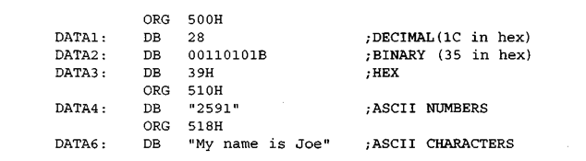
DB examples
<number>

Slide 53
ORG (origin)
The ORG directive is used to indicate the beginning of the address. The number that comes after ORG can be either in hex or in decimal. If the number is not followed by H, it is decimal and the assembler will convert it to hex. Some assemblers use “. ORG” (notice the dot) instead of “ORG” for the origin directive. Check your assembler.
<number>

Slide 54
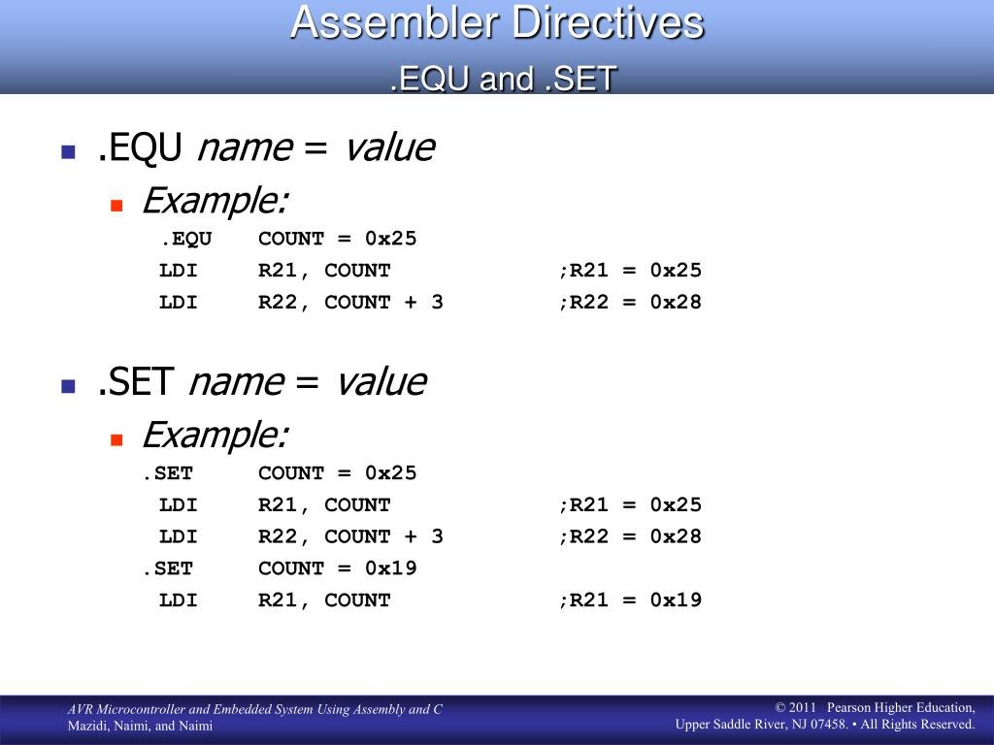
EQU (equate)
This is used to define a constant without occupying a memory location. The EQU directive does not set aside storage for a data item but associates a constant value with a data label so that when the label appears in the program, itp constant value will be substituted for the label. The following uses EQU for the counter constant and then the constant is used to load the R3 register.
<number>

Slide 55
END directive
Another important pseudocode is the END directive. This indicates to the assembler the end of the source (asm) file. The END directive is the last line of an 8051 program, meaning that in the source code anything after the END directive is ignored by the assembler. Some assemblers use “. END” (notice the dot) instead of “END”.
<number>

Slide 56
Rules for labels in Assembly language
By choosing label names that are meaningful, a programmer can make a program much easier to read and maintain. There are several rules that names must follow. First, each label name must be unique. The names used for labels in Assembly language programming consist of alphabetic letters in both uppercase and lowercase, the digits 0 through 9, and the special characters question mark (?), period (.), at (@), underline (_), and dollar sign ($). The first character of the label must be an alphabetic character.
In other words it cannot be a number. Every assembler has some reserved words that must not be used as labels in the program. Foremost among the reserved words are the mnemonics for the instructions. For example, “MOV” and “ADD” are reserved since they are instruction mnemonics. In addition to the mnemonics there are some other reserved words. Check your assembler for the list of reserved words.
<number>

Slide 57
What is an addressing mode
?
Addressing mode is a way to address an operand.
In other words, access data are modes.
various ways to called addressing
Operand means the data we are operating upon (in most cases source data).
It can be a direct address of memory, it can be register names, it can be any numerical data etc.

Slide 58
Addressing Modes
8051 provides a total of five distinct addressing modes.
1. Immediate
2.Register
3.Direct
4. Register indirect
5. Indexed

Slide 59
Immediate Addressing Modes
If the operand is a constant then it can be stored in memory immediately after the opcode.
immediate addressing is only of use when the data to be read is a constant
if your program needed to perform some calculations based on the number of weeks in the year, you could use immediate addressing to load the number 52 (34H) into a register and then perform arithmetic operations upon this data
MOV R0, #34H (2byte instruction)

Slide 60
Immediate Addressing
The above instruction is an example of immediate addressing. It moves the data 34H into R0
The assembler must be able to tell the difference between an address and a piece of data
The has symbol (#) is used for this purpose (whenever the assembler sees # before a number it knows this is immediate addressing)

Slide 61
Register Addressing
Often we need to move data from a register into the accumulator so that we can perform arithmetic operations upon it
For example, we may wish to move the contents of R5 into the accumulator.
MOV A, R5
This is an example of register addressing. It moves data from R5 (in the currently selected register bank) into the accumulator.
Another example, ADD A, R6

Slide 62
Direct Addressing
Direct addressing is used for accessing data in the on-chip RAM
MOV R0, 40H; save content of RAM
;location 40h in R0
MOV 56H,A; save content of A in RAM
;location 56H

Slide 63

Direct Addressing
Examples
MOV A,4
MOV A,R4 into ;A
; is same as
; which means copy R4
Applicable only for RB0 registers; since RAM location are 0 to 7 for R0 to R7 respectively of Register bank 0.

Slide 64

Register Indirect
Register addressing and direct addressing both restrict the programmer to manipulation of data in fixed addresses
The address the instruction reads from (MOV A, 30H) or writes to (MOV 30H,
cannot be altered while the
program is running.
There are times when it is necessary to read and write to a number of contiguous memory locations.

Slide 65
Register Indirect
For example, if you had an array of 8-bit numbers stored in memory, starting at address 30H, you may wish to examine the contents of each number in the array (perhaps to find the smallest number)
To do so, you would need to read location 30H, then 31H, then 32H and so on.

Slide 66
Register Indirect
This can be achieved using indirect addressing
R0 and R1 may be used as pointer registers
MOV A, @Ri
where Ri is either R0 or R1

Slide 67
Register Indirect
Now, we can read the contents of location 30H through indirect addressing
MOV R0, #30H MOV A, @R0
The first instruction is an example of immediate addressing whereby the data 30H is placed in R0
The second instruction is indirect addressing. It moves the contents of location 30H into the accumulator.

Slide 68
Register Indirect
If we now wish to get the data in location 31H we use the following:
INC R0
MOV A, @R0
This is just like the Pointers in C.

Slide 69

Indexed
Indexed addressing modes is widely used in accessing data elements of look up table entries located in the program ROM space of 8051.
The instruction used for this purpose is
MOVC A,@A+DPTR.
The 16-bit register DPTR and reg A are used to form the address of data element stored in on-chip ROM.

Slide 70
Indexed
Because the data elements are stored in the pragram(code) memory.
Instruction MOVC is used instead of MOV
C is for Code i.e. move data from code memory

Slide 71
Data Transfer instructions
Mnemonics | Operational description | Addressing mode | No. of bytes occupied
Mov a,#num | Copy the immediate data num in to acc | immediate | 2 ,1
Mov Rx,a | Copy the data from acc to Rx | register | 1,1
Mov a,Rx | Copy the data from Rx to acc | register | 1,1
Mov Rx,#num | Copy the immediate data num in to Rx | immediate | 2,1
Mov a,add | Copy the data from direct address add to acc | direct | 2,1
Mov add,a | Copy the data from acc to direct address add | direct | 2,1
Mov add,#num | Copy the immediate data num in to direct address | direct | 3,2
Mov add1,add2 | Copy the data from add2 to add1 | direct | 3,2
Mov Rx,add | Copy the data from direct address add to Rx | direct | 2,2
Mov add,Rx | Copy the data from Rx to direct address add | direct | 2,2
Mov @Rp,a | Copy the data in acc to address in Rp | Indirect | 1,1
Mov a,@Rp | Copy the data that is at address in Rp to acc | Indirect | 1,1

Slide 72
Data Transfer instructions
Mnemonics | Operational description | Addressing mode | No. of bytes occupied
Mov @Rp,#num | Copy the immediate byte num to the address in Rp | Indirect | 2
Movx a,@Rp | Copy the content of external add in Rp to acc | Indirect | 1
Movx a,@DPTR | Copy the content of external add in DPTR to acc | Indirect | 1
Movx @Rp,a | Copy the content of acc to the external add in Rp | Indirect | 1
Movx @DPTR,a | Copy the content of acc to the external add in DPTR | Indirect | 1
Movc a,@a+DPTR | The address is formed by adding acc and DPTR and its content is copied to acc | indirect | 1
Movc a, @a+PC | The address is formed by adding acc and PC and its content is copied to acc | indirect | 1
Push add | Increment SP and copy the data from source add to internal RAM address contained in SP | Direct | 2
Pop add | copy the data from internal RAM address contained in SP to destination add and decrement SP | direct | 2
Xch a, Rx | Exchange the data between acc and Rx | Register | 1
Xch a, add | Exchange the data between acc and given add | Direct | 2
Xch a,@Rp | Exchange the data between acc and address in Rp | Indirect | 1
Xchd a, @Rp | Exchange only lower nibble of acc and address in Rp | indirect | 1

Slide 73
Logical Instructions
Mnemonics | Operational description | Addressing mode | No. of bytes occupied | No. of cycles used
Anl a, #num | AND each bit of acc with same bit of immediate num, stores result in acc | Immediate | 2 | 1
Anl a, add | AND each bit of acc with same bit of content in add, stores result in acc | Direct | 2 | 1
Anl a, Rx | AND each bit of acc with same bit of content of Rx, stores result in acc | Register | 1 | 1
Anl a, @Rp | AND each bit of acc with same bit of content of add given by Rp, stores result in acc | Indirect | 1 | 1
Anl add, a | AND each bit of acc with same bit of direct add num, stores result in add | Direct | 2 | 1
Anl add, #num | AND each bit of direct add with same bit of immediate num, stores result in add | direct | 3 | 2
orl a, #num | OR each bit of acc with same bit of immediate num, stores result in acc | Immediate | 2 | 1
orl a, add | OR each bit of acc with same bit of content in add, stores result in acc | Direct | 2 | 1
orl a, Rx | OR each bit of acc with same bit of content of Rx, stores result in acc | Register | 1 | 1
orl a, @Rp | OR each bit of acc with same bit of content of add given by Rp, stores result in acc | Indirect | 1 | 1
orl add, a | OR each bit of acc with same bit of direct add num, stores result in add | Direct | 2 | 1
orl add, #num | OR each bit of direct add with same bit of immediate num, stores result in add | direct | 3 | 2
Xrl a, #num | XOR each bit of acc with same bit of immediate num, stores result in acc | Immediate | 2 | 1

Slide 74
Logical Instructions
Mnemonics | Operational description | Addressing mode | No. of bytes occupied
Xrl a, add | XOR each bit of acc with same bit of content in add, stores result in acc | Direct | 2
Xrl a, Rx | XOR each bit of acc with same bit of content of Rx, stores result in acc | Register | 1
Xrl a, @Rp | XOR each bit of acc with same bit of content of add given by Rp, stores result in acc | Indirect | 1
Xrl add, a | XOR each bit of acc with same bit of direct add num, stores result in add | Direct | 2
Xrl add, #num | XOR each bit of direct add with same bit of immediate num, stores result in add | direct | 3
Clr a | Clear each bit of acc | Direct | 1
Cpl a | Complement each bit of acc | direct | 1
Anl c, b | AND carry with given bit b, stores result in carry | — | 2
Anl c, /b | AND carry with complement of given bit b, stores result in carry | — | 2
Orl c, b | OR carry with given bit b, stores result in carry | — | 2

Slide 75
Logical Instructions
Mnemonics | Operational description | Addressing mode | No. of bytes occupied
Orl c, /b | OR carry with complement of given bit b, stores result in carry | — | 2
Cpl c | Complement carry flag | — | 1
Cpl b | Complement bit b | — | 2
Clr c | Clear carry flag | — | 1
Clr b | Clear given bit b | — | 2
Mov c, b | Copy bit b to carry | — | 2
Mov b, c | Copy carry to bit b | — | 2
Setb c | Set carry flag | — | 1
Setb b | Set bit b | — | 2
Rl a | Rotate acc one bit left | — | 1
Rr a | Rotate acc one bit right | — | 1
Rlc a | Rotate acc one bit left with carry | — | 1
Rrc a | Rotate acc one bit right with carry | — | 1
Swap a | Exchange upper and lower nibble of acc | — | 1

Slide 76
Arithmetic Instructions
Mnemonics | Operational description | Addressing mode | No. of bytes occupied
Inc a | Add 1 to acc | Register | 1
Inc Rr | Add 1 to register Rr | Register | 1
Inc add | Add 1 to the content of add | Direct | 2
Inc @rp | Add 1 to the content of the address in Rp | indirect | 1
Inc DPTR | Add 1 to DPTR | Register | 1
dec a | Subtract 1 from acc | Register | 1
dec Rr | Subtract 1 from Rr | Register | 1
dec add | Subtract 1 from content of add | Direct | 2
dec @rp | Subtract 1 from the content of address | indirect | 1
Add a, #num | Add the immediate num with acc and stores result in acc | immediate | 2
Add a, Rx | Add the data in Rx with acc and stores result in acc | Register | 1
Add a, add | Add the data in add with acc and stores result in acc | Direct | 2
Add a, @Rp | Add the data at the address in Rp with acc and stores result in acc | Indirect | 1
Addc a,#num | Add the immediate num with acc and carry, stores result in acc | immediate | 2
Addc a, Rx | Add the data in Rx with acc and carry, stores result in acc | Register | 1

Slide 77
Arithmetic Instructions
Mnemonics | Operational description | Addressing mode | No. of bytes occupied
Addc a, add | Add the data in add with acc and carry, stores result in acc | Direct | 2
Addc a, @Rp | Add the data at the address in Rp with acc and carry, stores result in acc | Indirect | 1
Subb a, #num | Subtract immediate num and carry from acc; stores the result in acc | immediate | 2
Subb a, add | Subtract the content of add and carry from acc; stores the result in acc | Register | 1
Subb a, Rx | Subtract the data in Rx and carry from acc; stores the result in acc | Direct | 2
Subb a, @Rp | Subtract the data at the address in Rp and carry from acc; stores the result in acc | Indirect | 1
Mul ab | Multiply acc and register B. store the lower byte of result in acc and higher byte in B | — | 1
div ab | divide acc by register B. store quotient in acc and remainder in B | — | 1
Da a | After addition of two packed BCD numbers, adjust the sum to decimal format | — | 1

Slide 78
Branching Instructions
Mnemonic | Operational description | No of bytes occupied
Jc label | Jump to label if carry is set to 1 | 2
Jnc label | Jump to label if carry is cleared to 0 | 2
Jb b,label | Jump to label if given bit is set to 1 | 3
Jnb b,label | Jump to label if given bit is cleared to 0 | 3
Jbc b,label | Jump to label if given bit is set. Clear the bit | 3
Cjne a, add, label | Compare the content of accumulator with the content of given address and if not equal jump to label | 3
Cjne a, #num, label | Compare the content of accumulator with immediate number and if not equal jump to label | 3
Cjne Rx, #num, label | Compare the content of Rx with the immediate number and if not equal jump to label | 3
Cjne @Rp, #num, label | Compare the content of location in Rp with immediate number and if not equal jump to label | 3
Djnz Rx, label | Decrement the content of Rx and jump to the label if it is not zero | 2
Djnz add, label | Decrement the content of address and jump to the label if it is not zero | 3

Slide 79
Branching Instructions
Mnemonic | Operational description | No of bytes occupied
Jz label | Jump to the label if content of accumulator is 0 | 2
Jnz label | Jump to the label if content of accumulator is not 0 | 2
Jmp @a+dptr | Jump to the address created by adding the contents on accumulator and dptr | 1
Ajmp sadd | Take a jump to absolute short range address sadd | 2
Ljmp ladd | Take a jump to absolute long range address sadd | 3
Sjmp radd | Take a jump to relative address radd | 2
nop | Short form of no operation means do nothing and go to next instruction | 1
Acall sadd | Pushes the content of Acc on stack and load it will absolute short range address sadd | 2
Lcall ladd | Pushes the content of Acc on stack and load it will absolute long range address sadd | 3
Ret | returns from subroutine by restoring the Acc from stack using pop operation | 1
reti | Returns from interrupt subroutine by restoring Acc from stack using pop operation | 1

